Slide 1

React food ordering app

Slide 2
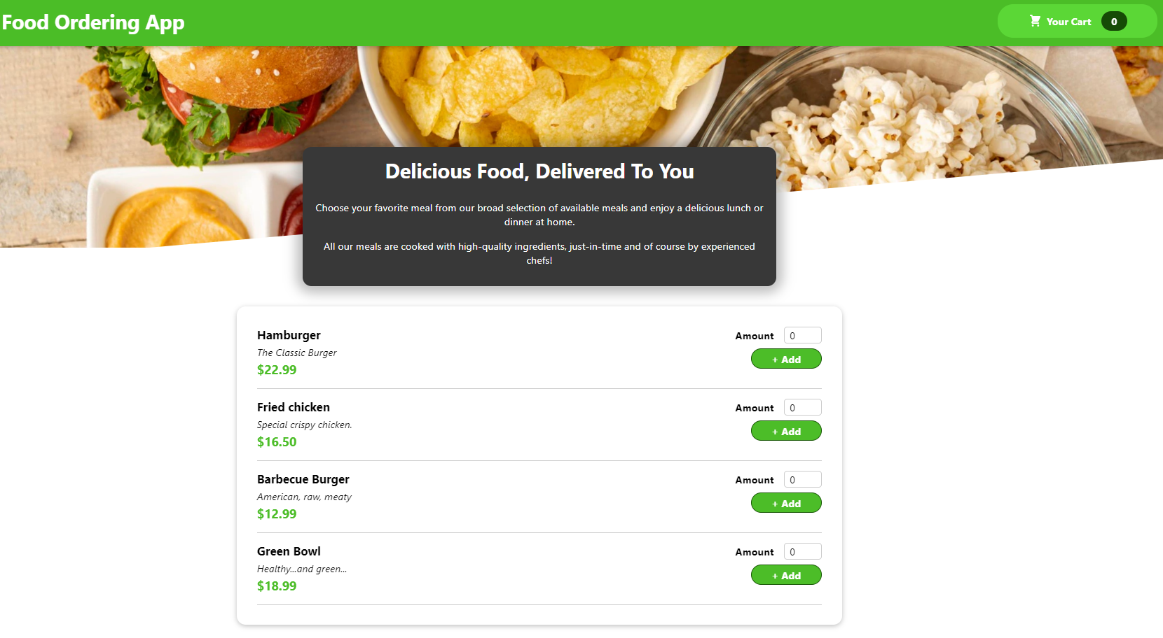
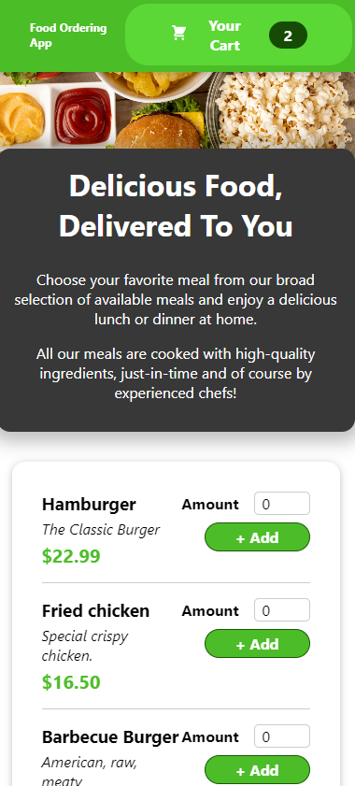
React food ordering app

Slide 3
Topics covering in project
1. useState
2. useContext
3. useRef
4. useEffect
5. useReducer
6. Events
7. Props
8. .map reducer
9. Split complex components into multiple components
10. CSS Modules
11. Modal Popup
12. svg Component
13. How we can structure projects and handle components
14. Fragments
15. Reusable components

Slide 4

Thank You
aamirpervez27@gmail.com

